Slide 1

Crime rate analysis
Guided by
Prof. Avinash Gondal
Group
20 Kritarth Kambli
37 Rahul Patil
39 Pooja Patkar
48 Vishal Shirke

Slide 2
introduction
Growing crime rate is a major concern and it is essential to find techniques to reduce it.
Crime analysis gives us better understanding of crime trends which is highly beneficial.
Ability to use big data for easy and efficient understanding of patterns.
In India, GIS (Geographic Information System) is used for crime mapping. But applications for GIS in policing is in starting stages and use of GIS based data analysis can be useful.

Slide 3
scope
Criminal data is available for public but it is mostly focused on combined data about a state. The data for individual cities is not easily accessible and is mostly in the form of FIR/charge sheets in local languages.
This can be solved by analyzing, classifying and creating a GIS environment for individual cities. Simple crime maps and statistical data in the form of graphs can help the police as well as the citizens in many ways.
Much of the current work is useful for policing and focused in two major directions:
Predicting surges and hotspots of crime and understanding patterns of criminal behavior that could help in solving criminal investigations.

Slide 4
Proposed system
For easy accessibility and use we propose to build a mobile application/website which will be available for public and private use.
The application will provide a brief overview of current state of crime.
The frontend of the application will focus on statistical data visualization and crime mapping.
The backend system will focus on generating accurate statistical data and intensity of crime for GIS mapping.

Slide 5
Project Workflow
RAW DATA
DATA PREPROCESSING
Data from various
Police station websites across the state
Data preprocessing
Data Integration
Data Reduction
Data cleaning
Data Transformation

Slide 6
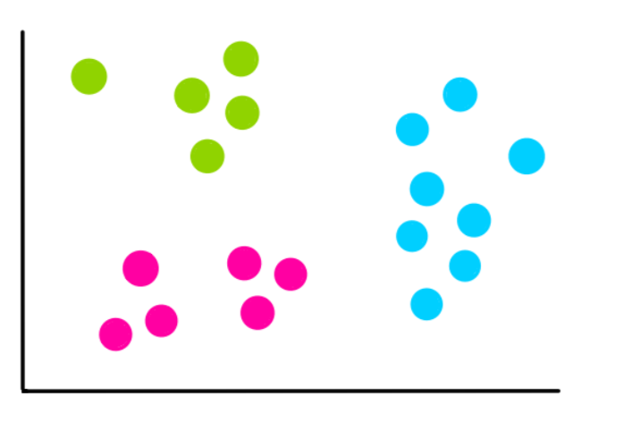
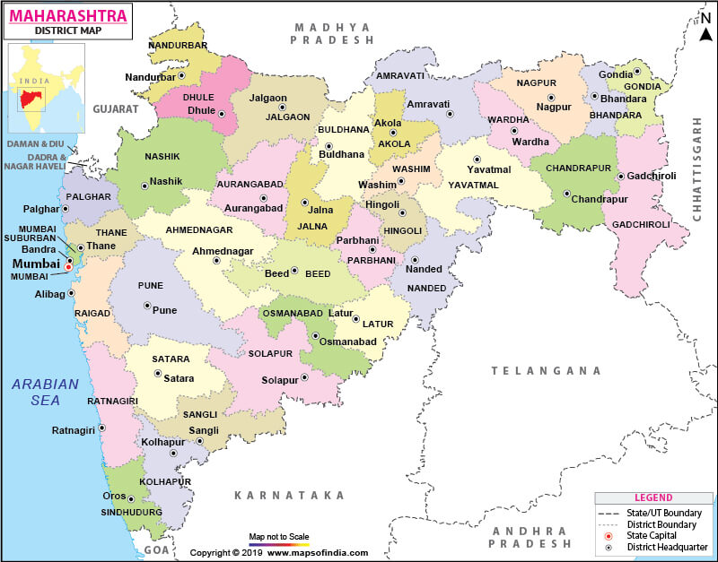
Project Workflow
Clustering
Classification
Visualization
KNN
Random Forest Classifier
Logistic Regression, etc.
K-Means

Slide 7
Project requirements
Hardware Requirements:
Computer/laptop
Intel i5 10th Gen or higher/8gb Ram
Software Requirements:
Python
Flask/Android/Flutter
HTML
CSS
JavaScript

Slide 8
References
Deepika K.K , Smitha Vinod(2018). Crime analysis in India using data mining techniques.
Devendra Tayal, Arti Jain, Surbhi Arora, Surbhi Agarwal, Tushar Gupta, Nikhil Tyagi, “Crime detection and Criminal identification in India using data mining technique”, Ai & Society, 2014, https://doi.org/10.1007/s00146-014-0539-6
Shivani Dandir(2019). Indian Crime Data Analysis. https://towardsdatascience.com/indian-crime-data-analysis-85d3afdc0ceb
Tapan Chakraborty.An Alternative to Crime Trend Analysis in India *https://www.satp.org/satporgtp/publication/faultlines/volume14/article5.htm
Vikramaditya Singh Bhatia,Sourabh Tiwarib, Jasvant Mandloic. Machine Learning Model to Predict, Classify and Analyze Crime in Indore City.
Prajakta Yerpude and Vaishnavi Gudur, “Predictive Modelling of Crime Dataset Using Data Mining”, International Journal of Data Mining & Knowledge Management Process (IJDKP), Vol.7, No.4, July 2017, DOI: 10.5121/ijdkp.2017.7404

Slide 9
!!! Thank you !!!

